Slide 1


ECE330 SoC Design Final Report
Kyritsis Spyridon, Konstantina Topali

Slide 2
Presentation Overview
Project Description
Functional Verification
Logic Synthesis
Placement & Routing
Post PnR
Timing & Power Reports
Post PnR
Functional Verification

Slide 3
Description
Our project is to apply the ASIC design flow and create an AES Encoder/Decoder system with error detection capabilities
Design source files
Author: Joachim Strömbergson
https://www.librecores.org/JoachimS/aes-128256
https://github.com/secworks/aes

Slide 4
Source Files
The project consists of mutually exclusive encipher and decipher blocks
Can be separated and function independently
The project’s source files include:
The RTL files for each submodule of the core’s implementation
Separate testbenches for each module
High-level test models for the AES algorithm parts
Written in Python

Slide 5
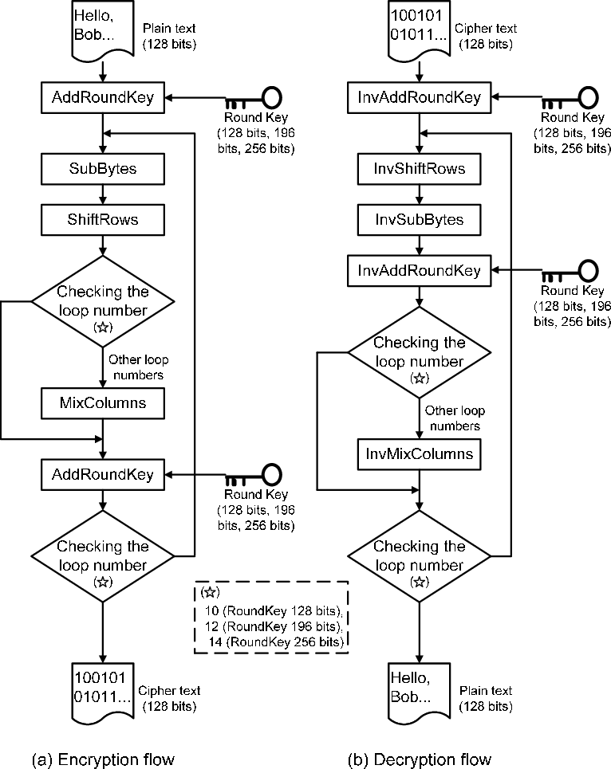
AES Algorithm
The AES (Advanced Encryption Standard) consists of 4 distinct operations
AddRoundKey
SubBytes
ShiftRows
MixColumns
The AES encryption and decryption algorithms are mirror images
For a given key the inverse operations are easily defined and carried out

Slide 6
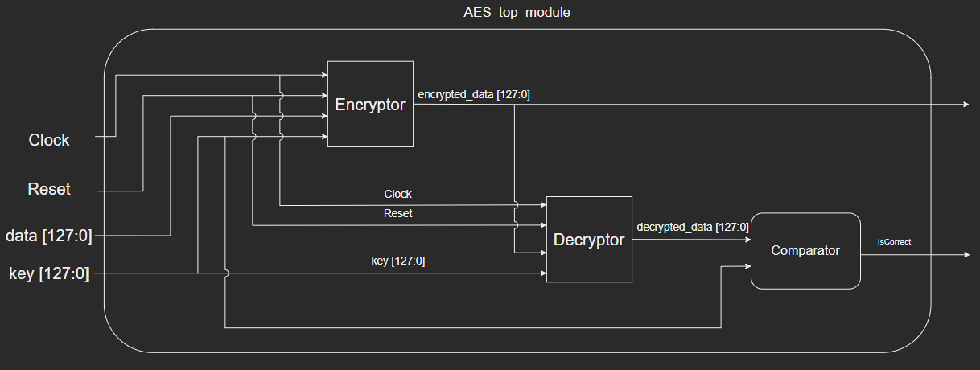
Block Diagram
Our project connects the encipher and decipher blocks in series
Our goal is to verify that the encryption and decryption modules function correctly
For the purposes of this project, we will only focus on 128-bit keys

Slide 7
Presentation Overview
Project Description
Functional Verification
Logic Synthesis
Placement & Routing
Post PnR
Timing & Power Reports
Post PnR
Functional Verification

Slide 8
Python Model Results
Contains tests for the AES128/256 implementations
Runs 4 different tests for all implementations
Runs tests for both encryption and decryption
Analytic results for each step of the algorithm

Slide 9
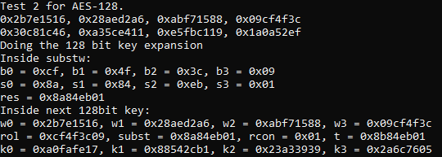
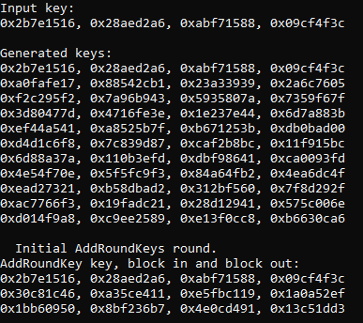
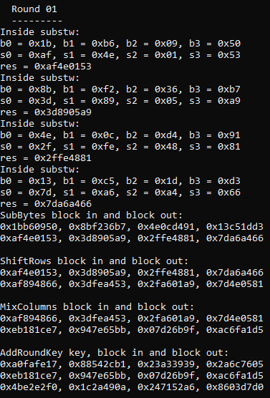
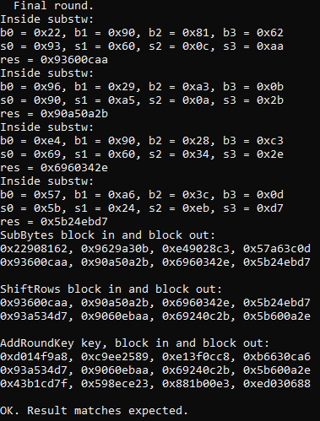
Python Model Results
….

Slide 10
Behavioural Simulation
For the behavioural simulation we will be using Cadence© Incisive™
We will be using an automated testbench
Compare our results VS Python Model
Test vectors copied from the following NIST documents:
NIST SP 800-38A:
http://csrc.nist.gov/publications/nistpubs/800-38a/sp800-38a.pdf
NIST FIPS-197, Appendix C:
https://nvlpubs.nist.gov/nistpubs/FIPS/NIST.FIPS.197.pdf

Slide 11
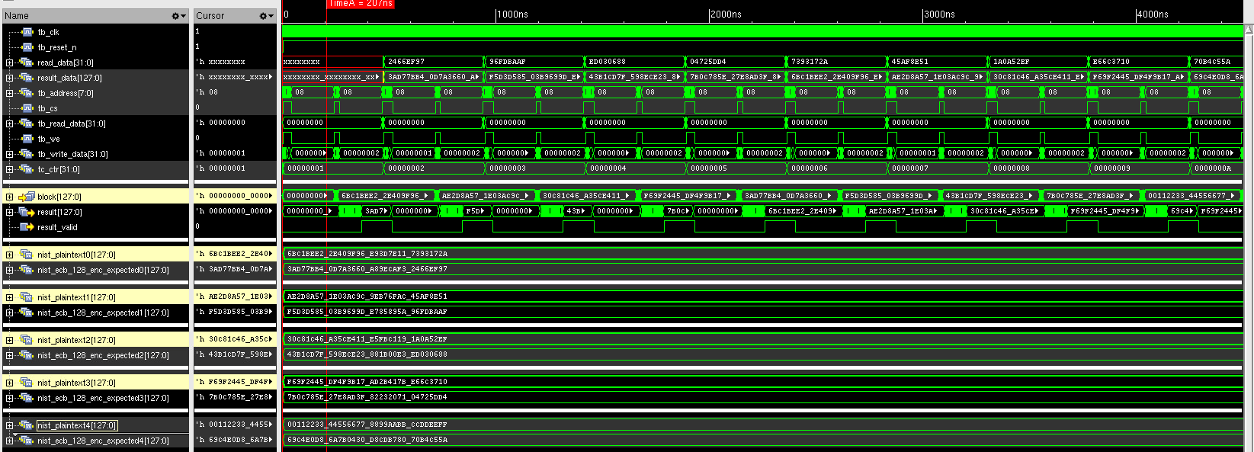
Behavioural Simulation

Slide 12
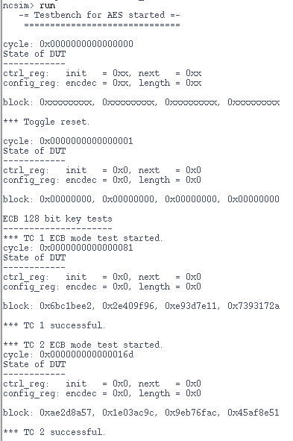
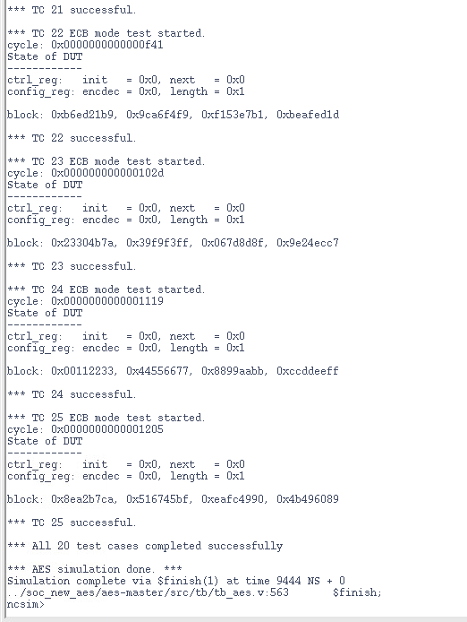
Behavioural Simulation
….

Slide 13
Presentation Overview
Project Description
Functional Verification
Logic Synthesis
Placement & Routing
Post PnR
Timing & Power Reports
Post PnR
Functional Verification

Slide 14
Logic Synthesis Methodology
Behavioral Simulation
Top-Down Logic Synthesis
Bottom-Up Logic Synthesis
Post Synthesis Simulation w/o delay annotation
Post Synthesis Simulation w/ delay annotation
Pareto Curve Creation

Slide 15



A lesson through…

Slide 16
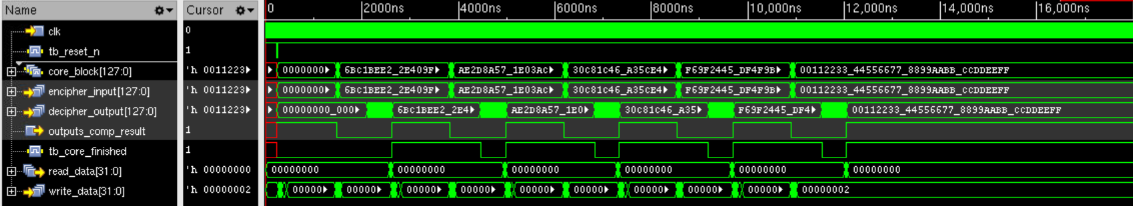
Behavioral Simulation
Behavioral Simulation
We tested our design be comparing its waveforms output to a software model
The outputs match
Top-Down Logic Synthesis
Bottom-Up Logic Synthesis
Post Synthesis Simulation w/o delay annotation
Post Synthesis Simulation w/ delay annotation
Pareto Curve Creation

Slide 17
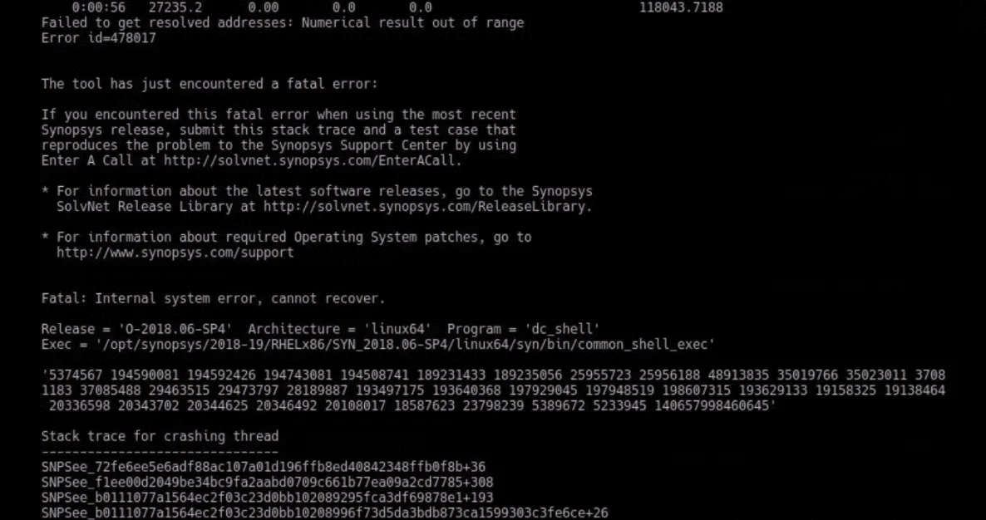
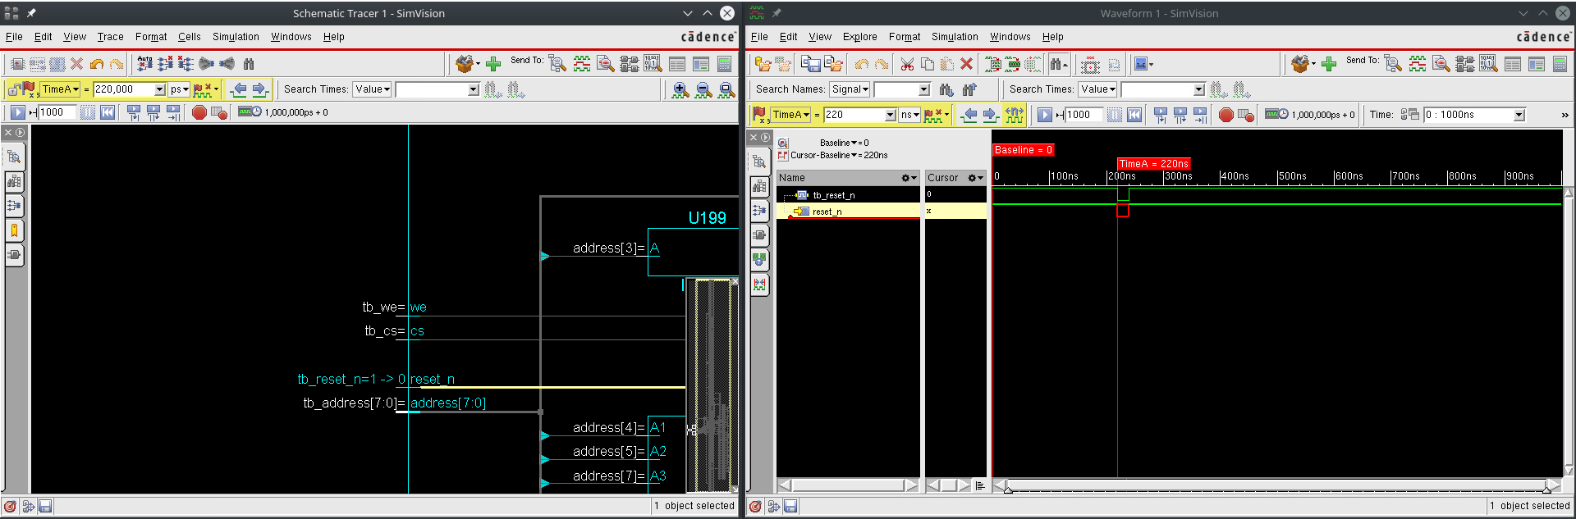
Problems (cont.)
In order to fix this mess
We switched to a newer version of Design Compiler™
Well…

Slide 18
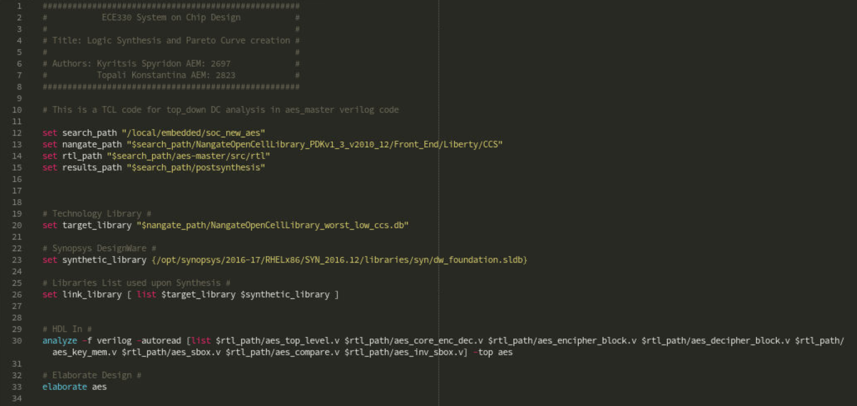
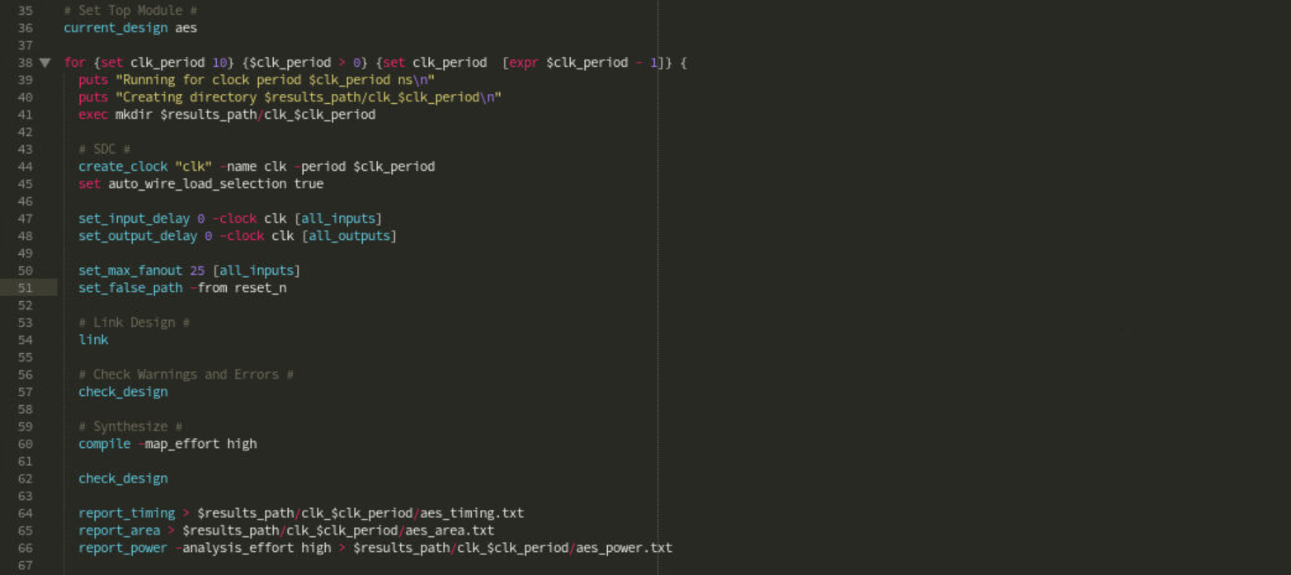
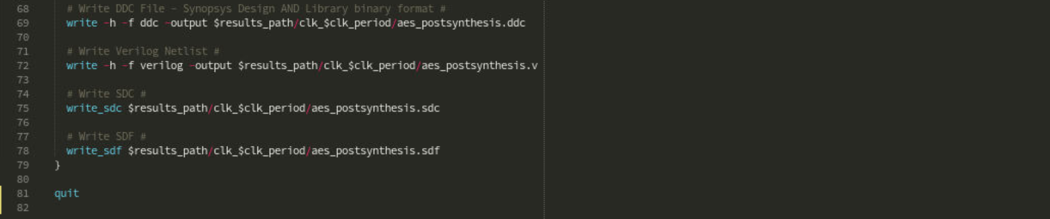
Top-Down Logic Synthesis
Behavioral Simulation
We created a top-down TCL script with clock_period starting from 1 ns to 10 ns
Top-Down Logic Synthesis
Bottom-Up Logic Synthesis
Post Synthesis Simulation w/o delay annotation
Post Synthesis Simulation w/ delay annotation
Pareto Curve Creation

Slide 19
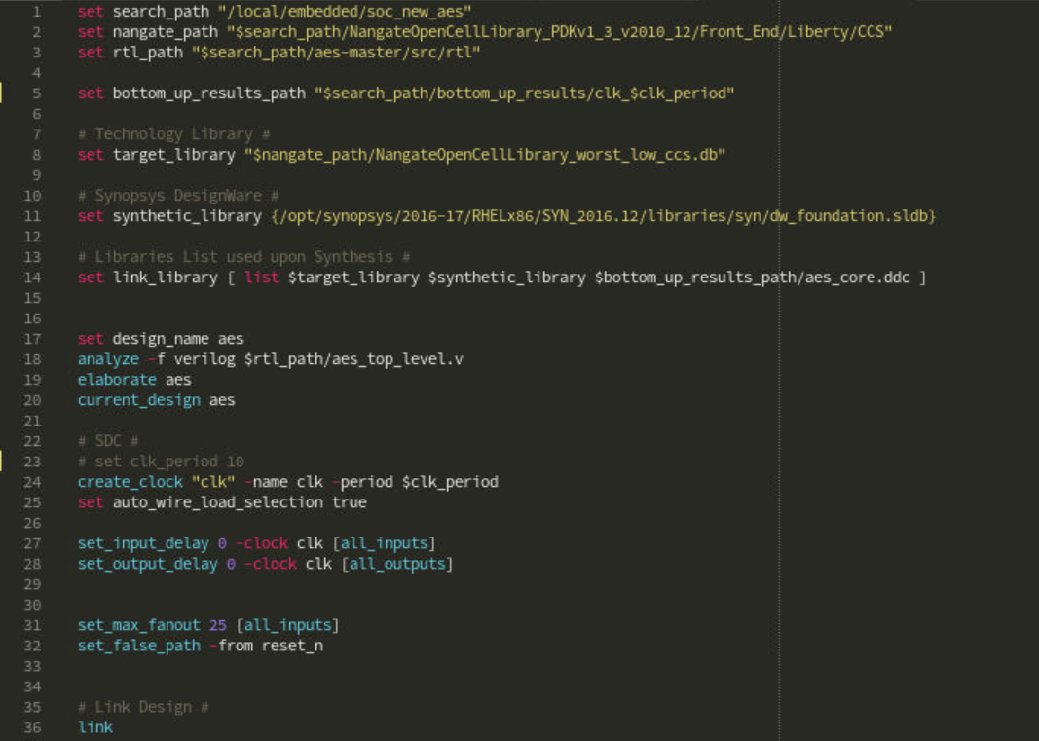
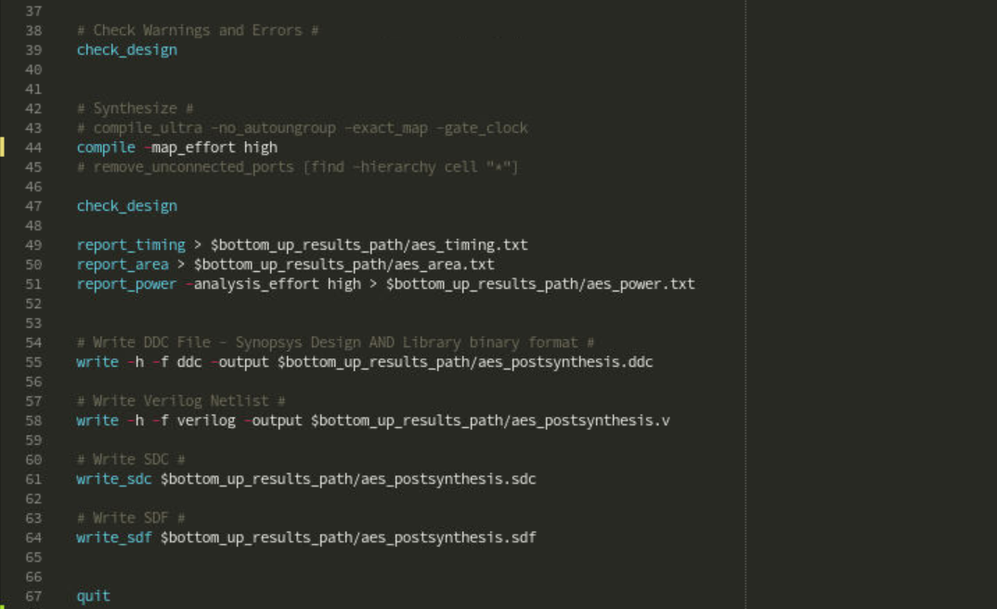
Bottom-Up Logic Synthesis
Behavioral Simulation
Then we created bottom-up TCL scripts with clock_period starting from 1 ns to 10 ns
Top-Down Logic Synthesis
Bottom-Up Logic Synthesis
Post Synthesis Simulation w/o delay annotation
Post Synthesis Simulation w/ delay annotation
Pareto Curve Creation

Slide 20
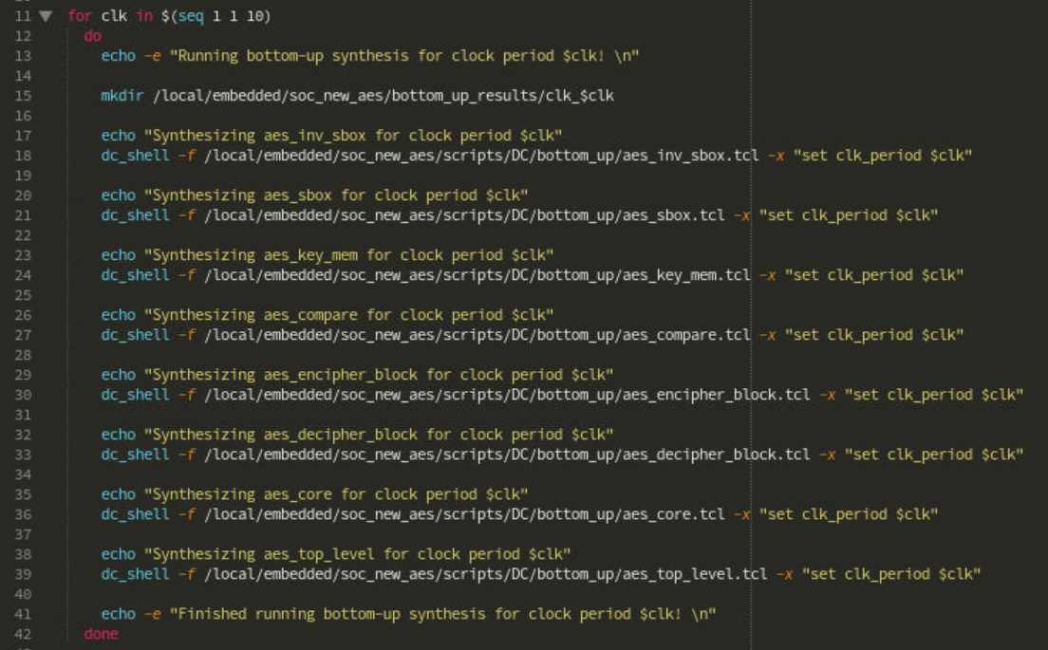
Bottom-Up Logic Synthesis
Behavioral Simulation
We created a bash script in order to automate the bottom-up synthesis for each clock_period
Top-Down Logic Synthesis
Bottom-Up Logic Synthesis
Post Synthesis Simulation w/o delay annotation
Post Synthesis Simulation w/ delay annotation
Pareto Curve Creation

Slide 21
Problems
This makes no sense
Apparently, it goes away if the reset is synchronous for some reason…

Slide 22
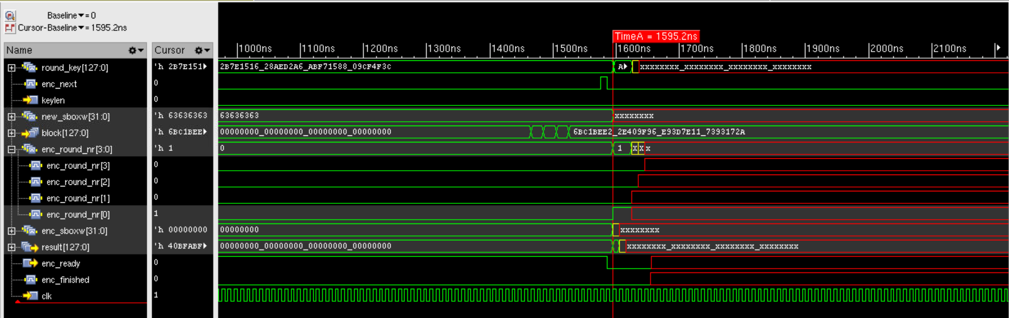
Post Synthesis Simulation w/o delay annotation
Behavioral Simulation
However, problems still occurred after the reset was fixed
Apparently, the issue is fixed if we use
compile -map_effort high
No clock gating
Top-Down Logic Synthesis
Bottom-Up Logic Synthesis
Post Synthesis Simulation w/o delay annotation
Post Synthesis Simulation w/ delay annotation
Pareto Curve Creation

Slide 23
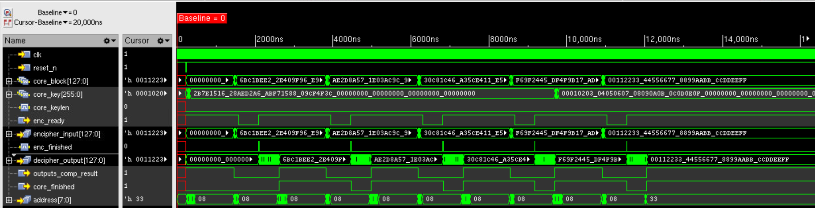
Top-Down and Bottom-Up Logic Synthesis
Behavioral Simulation
The results are positive
Top-Down Logic Synthesis
Bottom-Up Logic Synthesis
Post Synthesis Simulation w/o delay annotation
Post Synthesis Simulation w/ delay annotation
Pareto Curve Creation

Slide 24
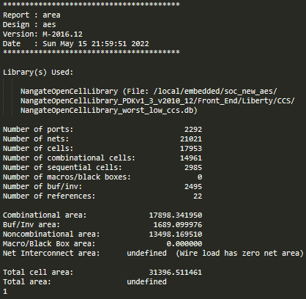
Top-Down Synthesis – Area.txt

Slide 25
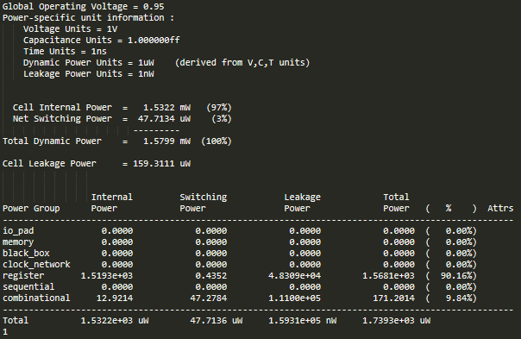
Top-Down Synthesis – Power.txt

Slide 26
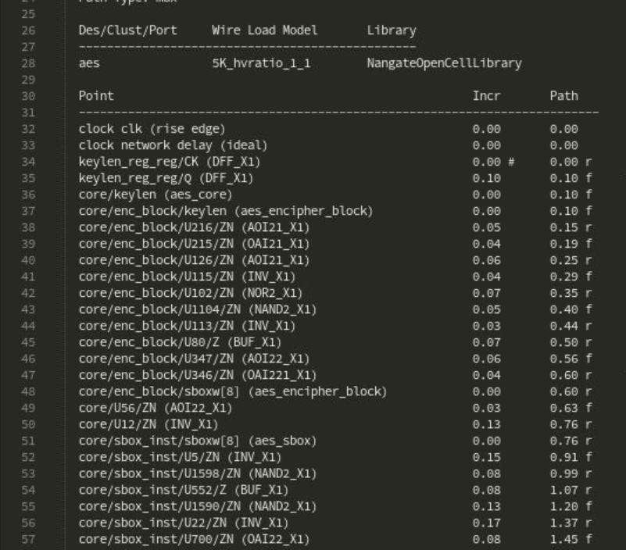
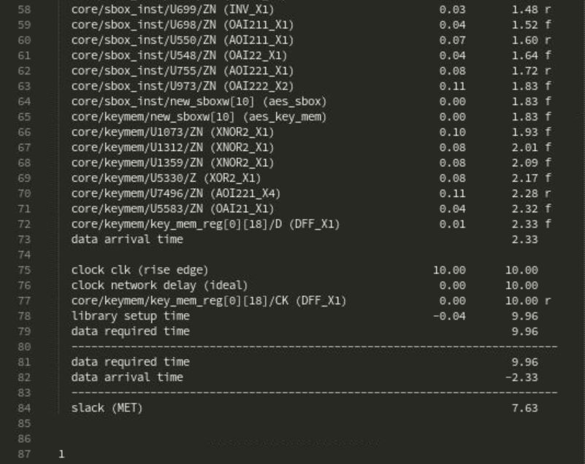
Top-Down Synthesis – Timing.txt
For 10ns clock_period
Slack is MET

Slide 27
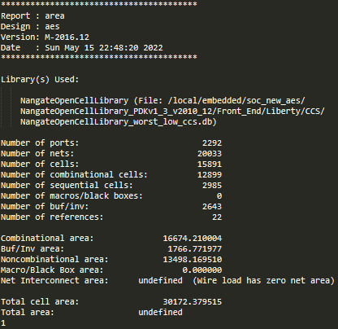
Bottom-Up Synthesis – Area.txt

Slide 28
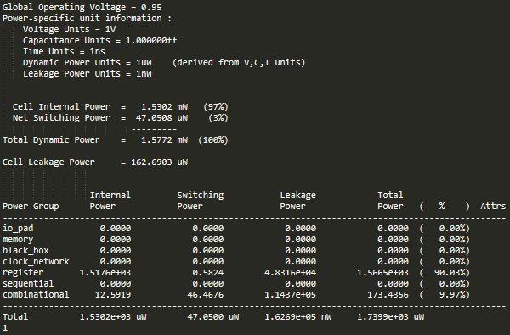
Bottom-Up Synthesis – Power.txt

Slide 29
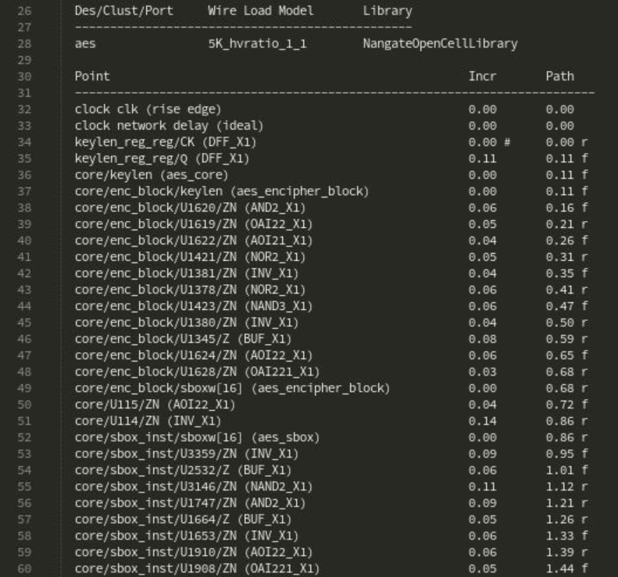
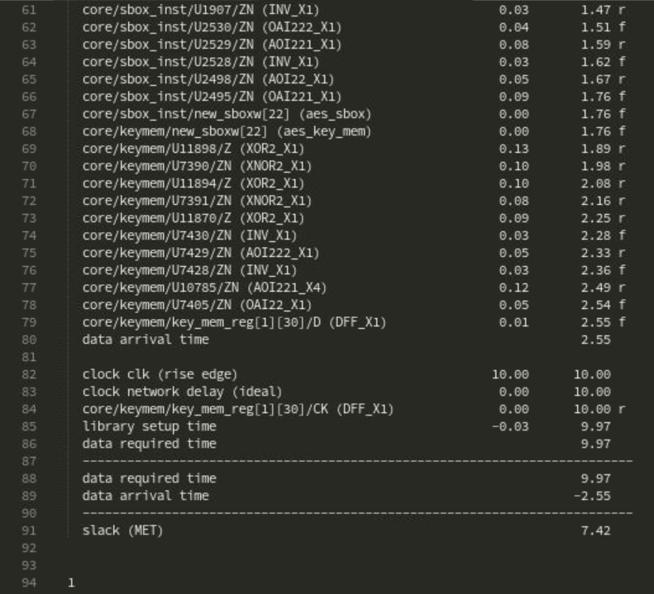
Bottom-Up Synthesis – Timing.txt
For 10ns clock_period
Slack is MET

Slide 30
Pareto Curves - Top-Down Synthesis
Behavioral Simulation
Area vs Time
Top-Down Logic Synthesis
Bottom-Up Logic Synthesis
Post Synthesis Simulation w/o delay annotation
Post Synthesis Simulation w/ delay annotation
Pareto Curve Creation

Slide 31
Pareto Curves - Top-Down Synthesis
Behavioral Simulation
Power vs Time
Top-Down Logic Synthesis
Bottom-Up Logic Synthesis
Post Synthesis Simulation w/o delay annotation
Post Synthesis Simulation w/ delay annotation
Pareto Curve Creation

Slide 32
Pareto Curves - Top-Down Synthesis
Behavioral Simulation
Slack vs Time
Top-Down Logic Synthesis
Bottom-Up Logic Synthesis
Post Synthesis Simulation w/o delay annotation
Post Synthesis Simulation w/ delay annotation
Pareto Curve Creation

Slide 33
Pareto Curves - Bottom-Up Synthesis
Behavioral Simulation
Area vs Time
Top-Down Logic Synthesis
Bottom-Up Logic Synthesis
Post Synthesis Simulation w/o delay annotation
Post Synthesis Simulation w/ delay annotation
Pareto Curve Creation

Slide 34
Pareto Curves - Bottom-Up Synthesis
Behavioral Simulation
Power vs Time
Top-Down Logic Synthesis
Bottom-Up Logic Synthesis
Post Synthesis Simulation w/o delay annotation
Post Synthesis Simulation w/ delay annotation
Pareto Curve Creation

Slide 35
Pareto Curves - Bottom-Up Synthesis
Behavioral Simulation
Slack vs Time
Top-Down Logic Synthesis
Bottom-Up Logic Synthesis
Post Synthesis Simulation w/o delay annotation
Post Synthesis Simulation w/ delay annotation
Pareto Curve Creation

Slide 36
Presentation Overview
Project Description
Functional Verification
Logic Synthesis
Placement & Routing
Post PnR
Timing & Power Reports
Post PnR
Functional Verification

Slide 37
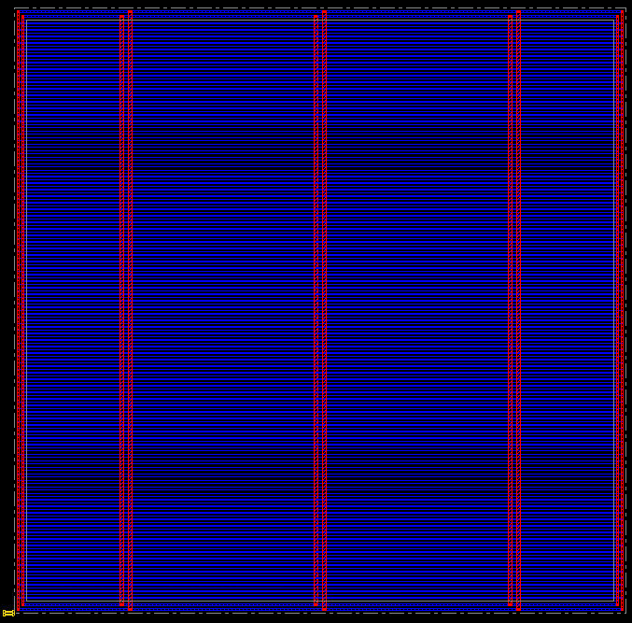
Floorplanning & Power Planning
Floorplanning & Power Planning
Placement
Clock Tree Synthesis
Routing
DRC Fixing
ECO optimizations
37

Slide 38
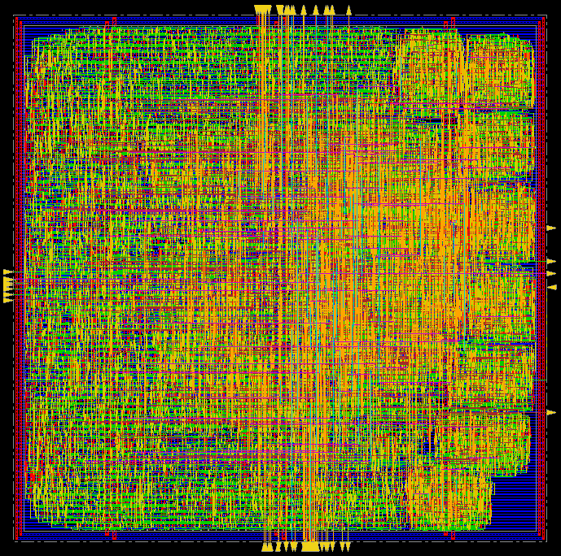
Placement
Floorplanning & Power Planning
Placement
Clock Tree Synthesis
Routing
DRC Fixing
ECO optimizations
38
38

Slide 39
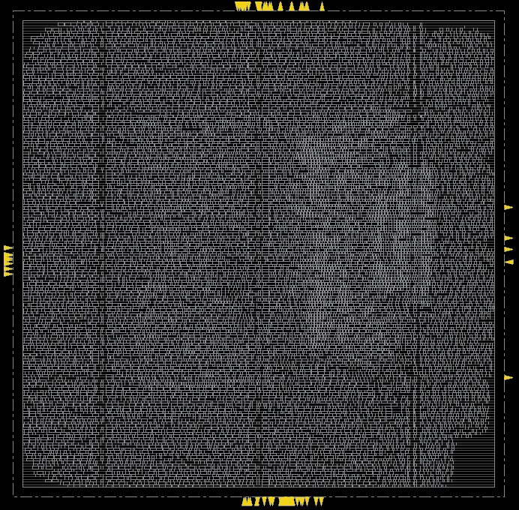
Placement
Floorplanning & Power Planning
Placement
Clock Tree Synthesis
Routing
DRC Fixing
ECO optimizations
39
39

Slide 40
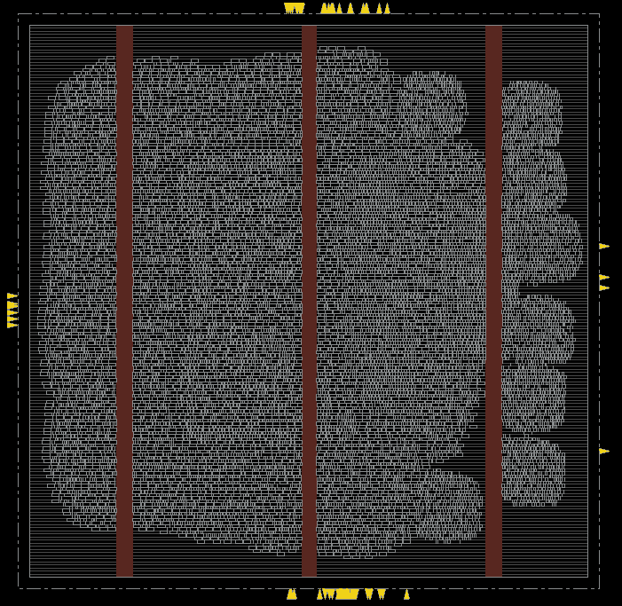
Placement
Floorplanning & Power Planning
Incremental run was needed to fix DRCs
Placement
Clock Tree Synthesis
Routing
DRC Fixing
ECO optimizations
40
40

Slide 41
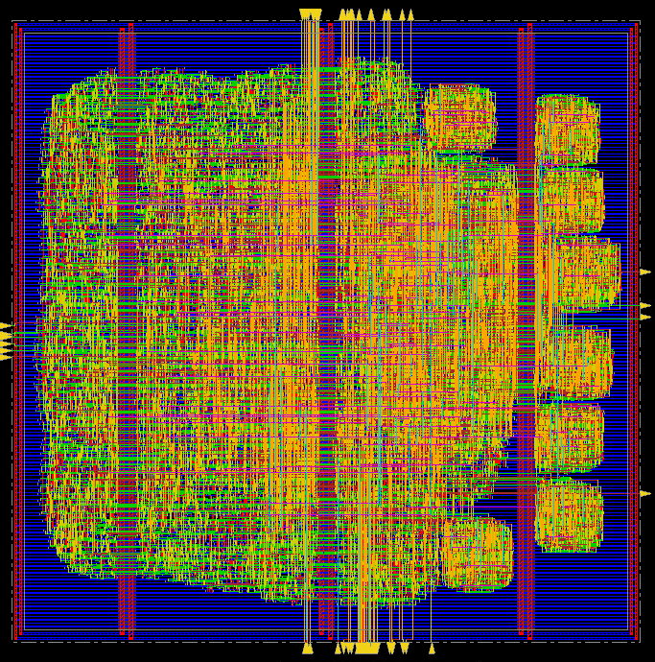
Placement
Floorplanning & Power Planning
Incremental run was needed to fix DRCs
Placement
Clock Tree Synthesis
Routing
DRC Fixing
ECO optimizations
41
41

Slide 42
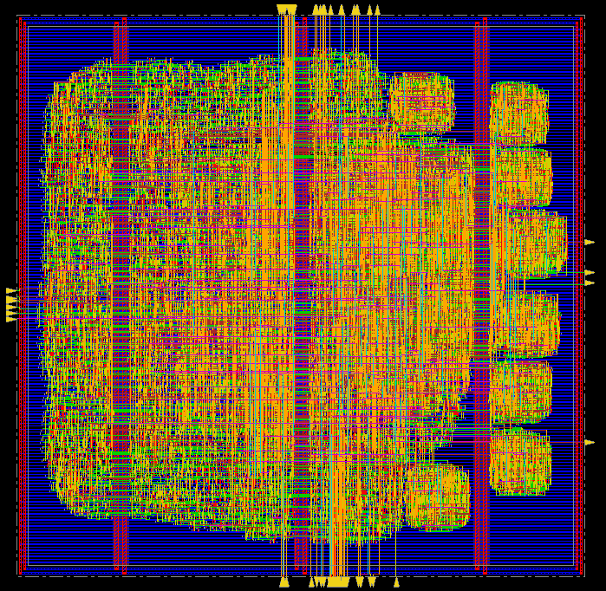
Clock Tree Synthesis
Floorplanning & Power Planning
Placement
Clock Tree Synthesis
Routing
DRC Fixing
ECO optimizations
42
42

Slide 43
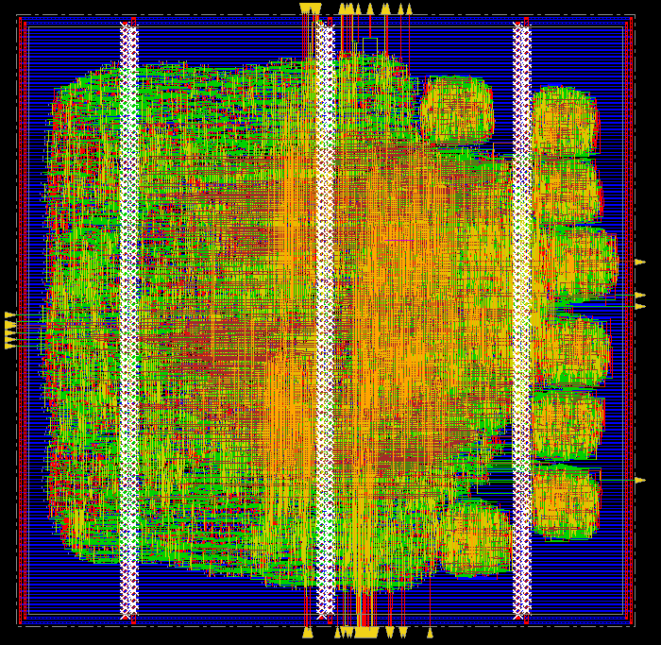
Routing
Floorplanning & Power Planning
Placement
Clock Tree Synthesis
Routing
DRC Fixing
ECO optimizations
43
43

Slide 44
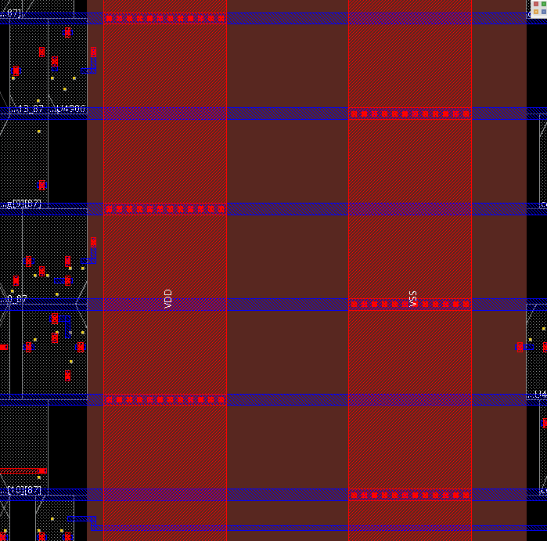
DRC Fixing
Floorplanning & Power Planning
Added vias where each power stripe intersects with its respecting powerline to fix the DRCs
Placement
Clock Tree Synthesis
Routing
DRC Fixing
ECO optimizations
44
44

Slide 45
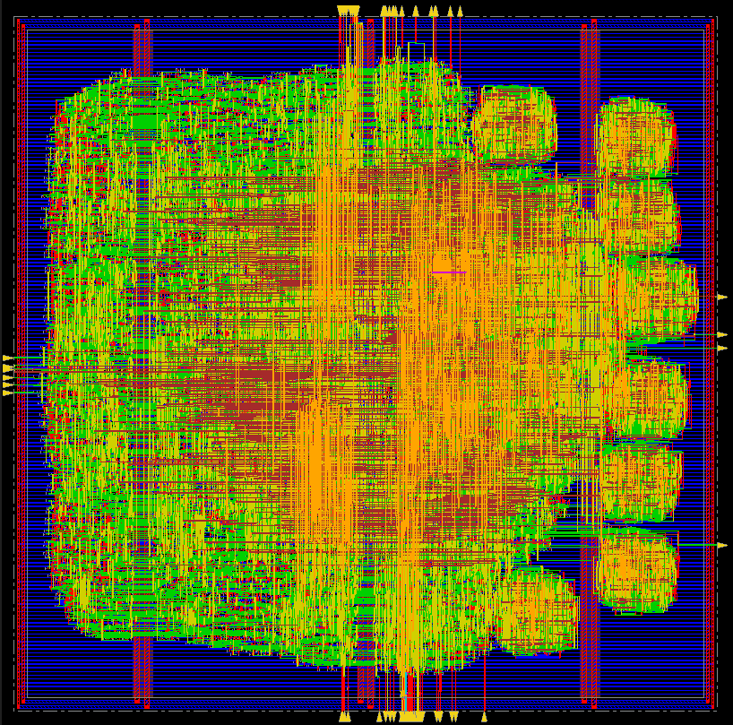
ECO optimizations
Floorplanning & Power Planning
ECO optimization round was necessary since our design did not meet hold timing
Placement
Clock Tree Synthesis
Routing
DRC Fixing
ECO optimizations
45
45

Slide 46
Final Routed Design

Slide 47
Presentation Overview
Project Description
Functional Verification
Logic Synthesis
Placement & Routing
Post PnR
Timing & Power Reports
Post PnR
Functional Verification

Slide 48
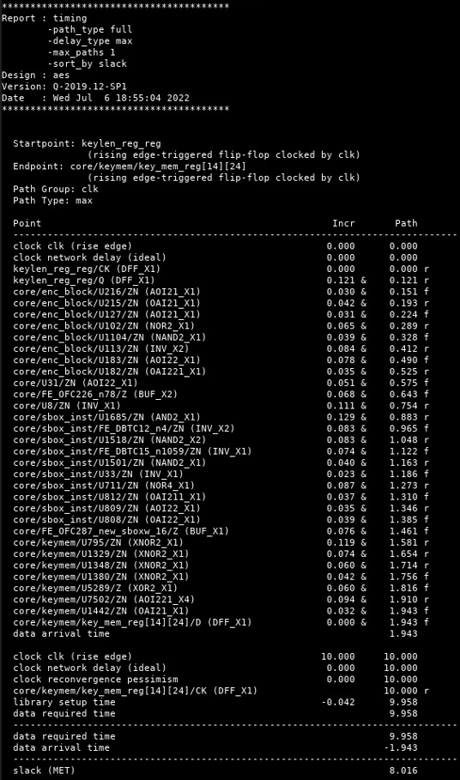
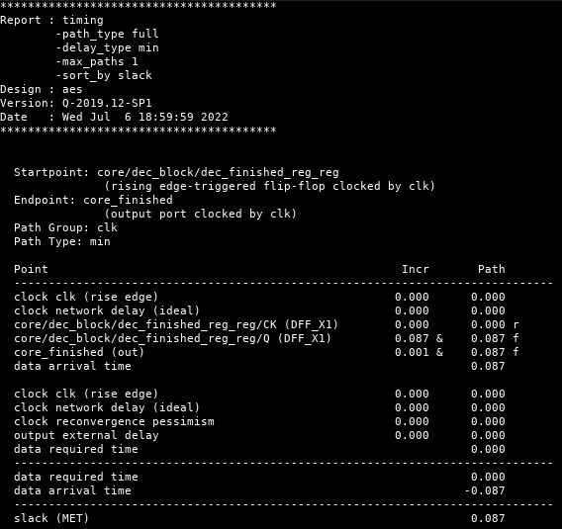
Post PnR Timing Reports
Timing report extracted from Synopsys© Primetime™

Slide 49
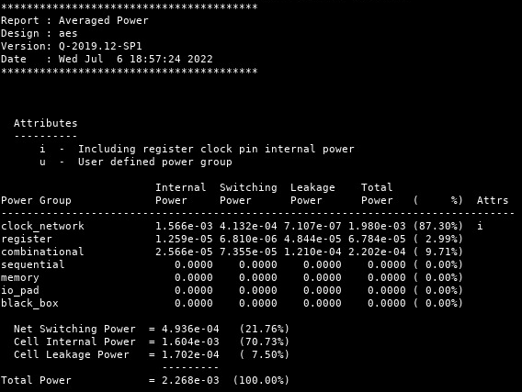
Post PnR Power Reports
Power report extracted from Synopsys© PrimePower™

Slide 50
Presentation Overview
Project Description
Functional Verification
Logic Synthesis
Placement & Routing
Post PnR
Timing & Power Reports
Post PnR
Functional Verification

Slide 51
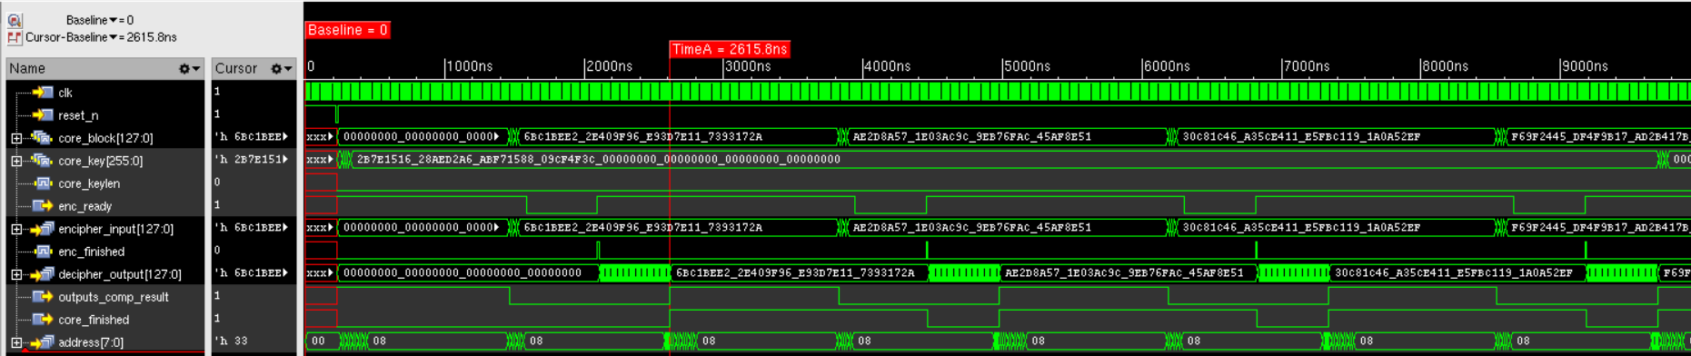
Post PnR Functional Verification
We provide Incisive™ with the post-PnR netlist and .sdf file
As we can observe our system functions as expected

